Slide 2
CHAPTER 18
Mobile Systems

Slide 3
The telephone will be used to inform people that a telegram has been sent.
—Alexander Graham Bell

Slide 4
Chapter Outline
Introduction
Energy
Network Connectivity
Sensors and Actuators
Resources
Life Cycle
Hardware First
Testing
Deploying Updates
Logging
Summary

Slide 5
Introduction
A mobile system has the ability to be in movement. This makes dealing with some of its characteristics a different matter from dealing with fixed systems. In this chapter we focus on five of those characteristics:
Energy: Mobile systems must be concerned with using power efficiently.
Network connectivity: Mobile systems must connect to other devices. but their mobility makes these connections tricky.
Sensors and actuators: Mobile systems tend to gain more information from sensors than fixed systems do, and they often use actuators to interact with their environment.
Resources: Mobile systems tend to be more resource-constrained than fixed systems. Because they must be small and lightweight therefore limited on the resources they can provide.
Life cycle: Testing mobile systems differs from the testing of other systems. Deploying new versions also introduces some special issues.

Slide 6
Energy
In this section, we focus on the architectural concerns most relevant to managing the energy of mobile systems.
Monitoring the Power Source
We have introduced a category of tactics called resource monitoring for monitoring the usage of computational resources.
In mobile systems, we need to monitor the energy source, so that we can initiate appropriate behavior when the energy available becomes low.
A smart battery is a rechargeable battery pack with a built-in battery management system (BMS). The BMS can be queried to get the current state of the battery.
Battery-powered mobile systems include a component, often in the kernel of the operating system, that knows how to interact with the BMS and can return the current battery capacity on request.

Slide 7
Energy
Throttling Energy Usage
Energy usage can be reduced by either terminating or degrading portions of the system that consume energy; this is the throttle usage tactic described in chapter 6.
A common example is reducing the brightness or the refresh rate of the display on a smartphone.
Tolerating a Loss of Power
Mobile systems should gracefully tolerate power failures and restarts.
Example requirements for these systems:
The system’s computer does not suffer permanent damage if power is cut at any time.
The system’s computer (re)starts the OS robustly whenever sufficient power is provided.
The runtime environment can be killed at any moment without affecting the integrity of the binaries, configurations, and operational data in permanent storage.
Applications need a strategy to deal with data that arrives while the application is inoperative.

Slide 8
Network Connectivity
Wireless networks are categorized based on the distance over which they operate.
Within 4 centimeters: Near Field Communication (NFC).
Within 10 meters: The IEEE 802.15 family of standards covers this distance (Such as Bluetooth)
Within 100 meters: The IEEE 802.11 family of standards (Wi-Fi) is used within this distance.
Within several kilometers: The IEEE 802.16 standards (WiMAX) cover this distance.
More than several kilometers: This is achieved by cellular or satellite communication.
Number of communication interfaces to support
There are many ways a device can connect to networks (Wi-Fi, Bluetooth, 5G, etc.).
Architect’s job: Be selective—only use what’s really needed. Too many interfaces increase power usage, heat, and take up space.

Slide 9
Network Connectivity
Movement from One Protocol to Another
Sometimes, multiple network options are available at once.
Architect’s job: The system should pick the best option automatically based on factors like speed, cost or battery life.
Modifiability
New communication technologies will emerge over time.
Architect’s job: Make it easy to add or replace parts of the system later so it can support new or updated network protocols.
Bandwidth
Different types of data (e.g., video vs. text) need different speeds, volumes, and delays.
Architect’s job: Understand what kind of data will be sent and choose protocols that match the performance needs (e.g., low latency for video calls).

Slide 10

Network Connectivity
Intermittent/Limited/No Connectivity
Sometimes, a device will temporarily lose its network connection.
Architect’s job: Design the system so it can handle network loss gracefully—save data, retry later, or switch to offline mode without breaking or losing work.
Security
Mobile communications are easy targets for attacks like data theft or fake networks.
Architect’s job: Protect communication with strong security measures (encryption, authentication, etc.) and be ready to respond to attacks.

Slide 11
Sensors and Actuators
A sensor is a device that detects the physical characteristics of its environment and translates those characteristics into an electronic representation.
An architect has several concerns with respect to sensors:
How to create an accurate representation of the environment based on the sensor inputs.
How the system should respond to that representation of the environment.
Security and privacy of the sensor data and actuator commands.
Degraded operation. If sensors fail or become unreadable, the system should enter a degraded mode.
For example, if GPS readings are not available in tunnels, the system can use dead reckoning techniques to estimate location.
Here we will focus on only the first concern.
This is performed using the sensor stack—a confederation of devices and software drivers that help turn raw data into interpreted information about the environment.

Slide 12
Sensors and Actuators
Some of the functions that must be achieved in the stack:
Reading raw data
The lowest level of the stack is a software driver to read the raw data.
The period frequency is a parameter that will influence both the processor load and the accuracy of the created representation.
Smoothing data
Raw data usually has a great deal of noise or variation.
Smoothing techniques take multiple readings over time to create a more reliable result.
Converting Data
Different sensors might measure the same thing but report it in different formats.
The system must standardize these readings.
Sensor Fusion
No single sensor gives the full picture.
Sensor fusion means combining data from multiple different sensors to get a better understanding.

Slide 13
Resources
An architect must make a number of important decisions surrounding resources and their usage:
Assigning tasks to electronic control units (ECUs)
Larger mobile systems (like cars or planes) have multiple ECUs (small computers), and the architect must decide which software tasks go to which ECU.
Fit of the ECU to the function: Put functions on ECUs powerful enough to handle them.
Criticality: More powerful ECUs may be reserved for critical functions.
Location in the vehicle: Sometimes, location matters—e.g., First-class passengers may have better Wi-Fi connectivity than second-class passengers.
Connectivity: If a function is split across ECUs, they must be able to communicate easily over the internal network.
Locality of Communication: Functions that talk to each other a lot should be on the same ECU to reduce communication delays and traffic.
Cost: Typically, a manufacturer wants to minimize the number of ECUs deployed.

Slide 14
Resources
Offloading functionality to the cloud
Some tasks (like route calculation or image recognition) can be handled partly on the device and partly in the cloud, where there's more power and storage.
The architect must determine:
Decide what stays local and what goes to the cloud.
Consider device power, network reliability, latency, local storage, and privacy.
Shutting down functions depending on the mode of operations
When certain features aren’t needed; they should be turned off or scaled down to save resources.
Strategy for displaying information
This issue is tied to available display resolution.
Low resolution (e.g., 320×320): Requires minimizing the information on the display.
High resolution (e.g., 1280×720): Can show richer, more detailed displays

Slide 15
Life Cycle
Mobile systems (like smartphones, cars, drones, etc.) have special or unusual traits in their development and maintenance processes.
Architects must adapt their decisions accordingly.
The architect must be concerned with the
hardware choices
Testing
deploying updates
logging

Slide 16
Hardware First
In mobile systems, hardware is often selected before software design begins, which means the software must adapt to hardware constraints.
Hardware choices are usually made by management, sales teams, or regulatory and their goal is mostly to minimize risk (e.g., cost, legal compliance), not to optimize software quality.
Advice to architects:
Instead of waiting for these decisions to be handed down, the software architect should participate early in discussions to explain tradeoffs and help guide better choices.

Slide 17
Testing
Mobile devices present some unique considerations for testing
Test display layouts
Mobile devices come in many different screen sizes and shapes, so it's important to test how the user interface looks and behaves across all of them.
Automatic layout tools (like HTML/CSS rendering) can fail on very small or unusual screens.
These problems can be hard to detect unless very thorough and device-specific testing is done.
Test operational edge cases
If the device runs out of battery or suddenly shuts down, the app should Not lose the user’s work or state. And be able to recover gracefully.
When the user interface does not react correctly, re-creating the sequence of events that caused the problem is difficult
the problem may depend on the timing, or on a specific set of operations.
Test resource usage
Test how the system uses resources like battery, memory, or CPU.

Slide 18
Testing
Test for network transitions
The system must handle changing from one network to another (like Wi-Fi to 4G to another Wi-Fi) without disrupting the user experience.
Suppose we are testing a car’s lane keep assist function, where the vehicle stays in the lane defined by markings without driver input. Testing of this system may address the following levels:
Software component: Testing just the individual piece of software (e.g. the lane detection algorithm)
Function: Testing the complete lane keep assist function (which involves multiple software components like mapping, camera inputs, etc.)
Device: Deploying the lane keep assist software onto the actual ECU hardware it will run on.
System: Testing the fully integrated car system.
Test traceability: If an issue is found in step 4, it needs to be reproducible and traceable through all test setups.

Slide 19
Deploying Updates
when a mobile device receives a system update, it usually serves one or more of these purposes: Fix issues, Provide new functionality, or Install unfinished features.
Modern cars, for example, require software updates, which are fetched over networks or downloaded via USB interfaces.
Beyond enabling system updates, architects must also address several key concerns such as data consistency, safety, deployment efficiency, and system extendibility.
Maintaining data consistency: Upgrades are usually one-way, so storing data in the cloud helps but cloud interactions must be tested.
Safety: Updates should only happen in safe system states, never during risky times like while a car is moving.

Slide 20
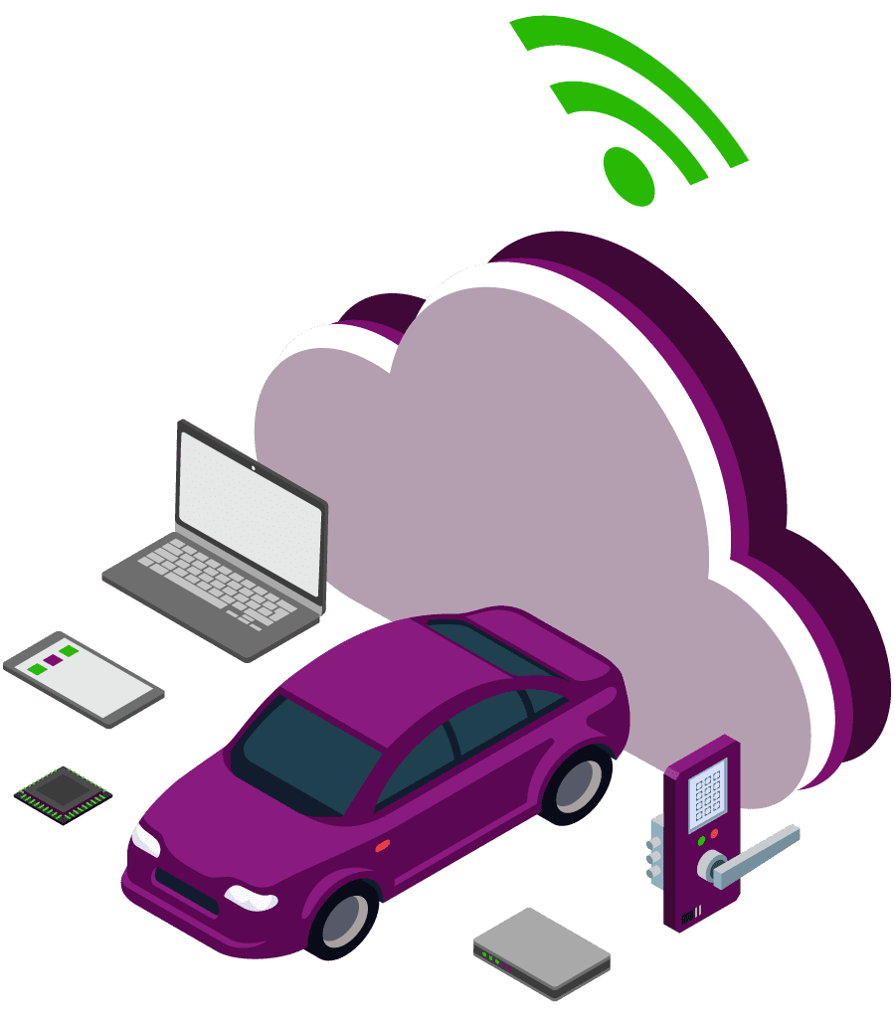
Deploying Updates
Partial system deployment: Design the system so that only small, frequently changing parts can be updated easily and automatically.
Extendibility: Mobile vehicle systems tend to have relatively long lifetimes. Retrofitting them will likely become necessary at some point.
Retrofitting means adding new technology to old systems, either by replacement or addition.

Slide 21
Logging
Logs are critical when investigating and resolving incidents that have occurred or may occur.
In mobile systems, the logs should be offloaded to a location where they are accessible regardless of the accessibility of the mobile system itself.
Many software applications do something similar when they encounter a problem and ask for permission to send the details to the vendor.
For mobile systems, this logging capability is particularly important, and they may very well not ask permission to obtain the data.

Slide 22
Summary
The differences between mobile systems and fixed systems is based on five characteristics: energy, connectivity, sensors, resources, and life cycle.
Energy usage in mobile systems can be controlled by throttling individual applications. Applications should be constructed to survive power failures and restart seamlessly when power is restored.
Connectivity means connecting to other systems and the Internet through wireless means.
Mobile systems utilize a variety of sensors. It may take multiple sensors to develop a meaningful representation.
Resources have physical characteristics such as size and weight, have processing capabilities, and carry a cost. The design choices involve tradeoffs among these factors.
Life-cycle issues include choice of hardware, testing, deploying updates, and logging. Testing and deployment of the user interface may be more complicated with mobile systems.

